Slide 1
Image Transformations
COMPUTER VISION

Slide 2
Coordinate Systems
The use of coordinate systems is fundamental to computer graphics
Coordinate systems are used to describe the locations of points in space
Multiple coordinate systems make graphics algorithms easier to understand and implement

Slide 3
Coordinate Systems (2)
Different coordinate systems represent the same point in different ways
Some operations are easier in one coordinate system than in another
v
(2,3)
v
(1,2)
y
y
u
u
x
x

Slide 4
Objectives
Introduce standard transformations
  Rotation
  Translation
  Scaling
  Shear
Derive homogeneous coordinate transformation matrices
Learn to build arbitrary transformation matrices from simple transformations
COMPUTER VISION

Slide 5
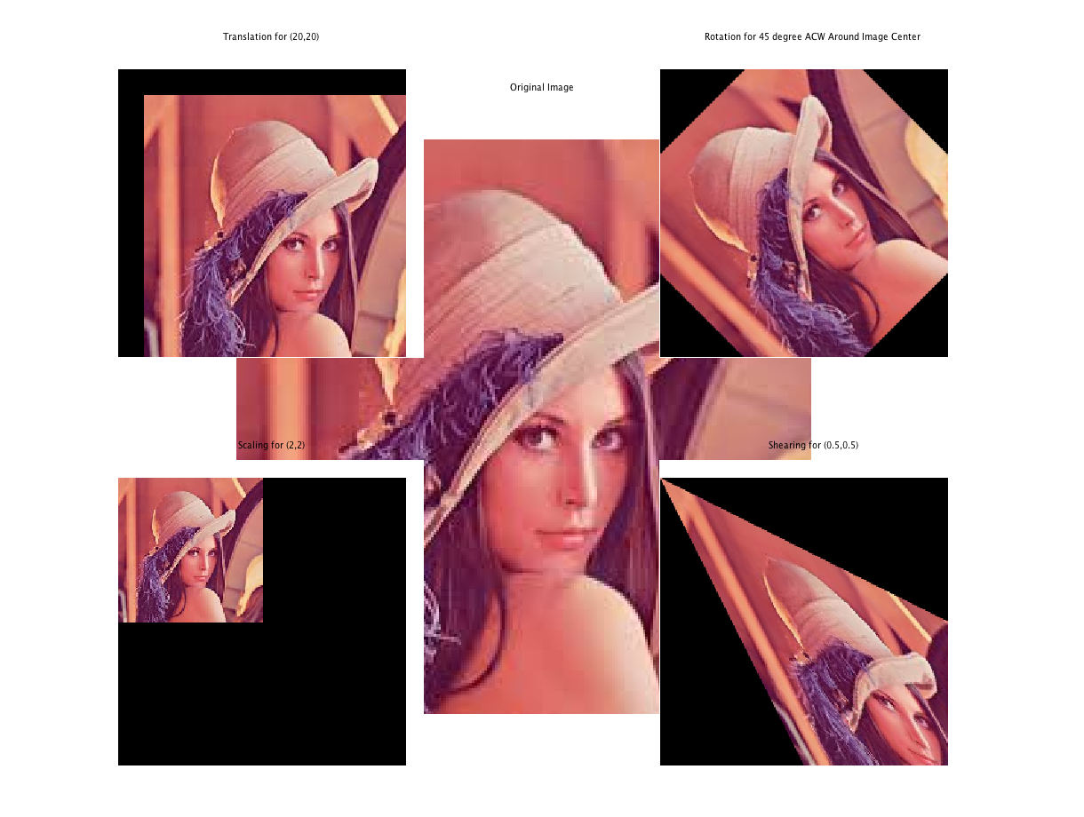

Slide 6
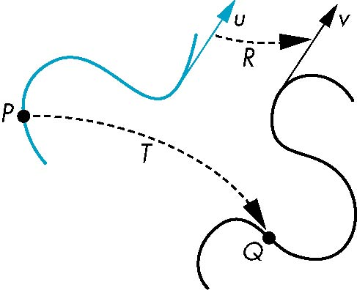
General Transformations
A transformation maps points to other points and/or vectors to other vectors
v=T(u)
Q=T(P)
COMPUTER VISION

Slide 7
Transformations
(Alternate Interpretation)
Transformations modify an object’s shape and location in one coordinate system
(2,3)
x’=x-1
y’=y-1
y
y
(1,2)
x=x’+1
y=y’+1
x
x

Slide 8
Affine Transformations
Line preserving
Characteristic of many physically important transformations
  Rigid body transformations: rotation, translation
  Scaling, shear
Importance in graphics is that we need only transform endpoints of line segments and let implementation draw line segment between the transformed endpoints
COMPUTER VISION

Slide 9
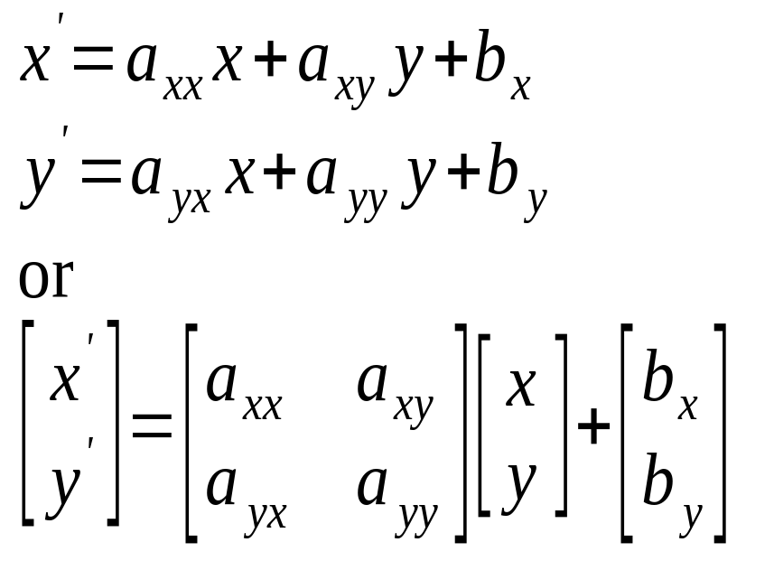
2D Affine Transformations
An affine transformation is one that can be written in the form:

Slide 10
Why Affine Transformations?
Affine transformations are linear
  Transforming all the individual points on a line gives the same set of points as transforming the endpoints and joining them
  Interpolation is the same in either space: Find the halfway point in one space, and transform it. Will get the same result if the endpoints are transformed and then find the halfway point

Slide 11
Pipeline Implementation
T
(from application program)
frame
buffer
u
transformation
T(u)
rasterizer
v
T(v)
T(v)
T(v)
v
T(u)
u
T(u)
vertices
vertices
pixels
COMPUTER VISION

Slide 12
Notation
We will be working with both coordinate-free representations of transformations and representations within a particular frame
P,Q, R: points in an affine space
u, v, w: vectors in an affine space
α, β, γ: scalars
p, q, r: representations of points
-array of 4 scalars in homogeneous coordinates
u, v, w: representations of points
-array of 4 scalars in homogeneous coordinates
COMPUTER VISION

Slide 13
Translation
Move (translate, displace) a point to a new location
Displacement determined by a vector d
  Three degrees of freedom
  P’=P+d
P’
d
P
COMPUTER VISION

Slide 14
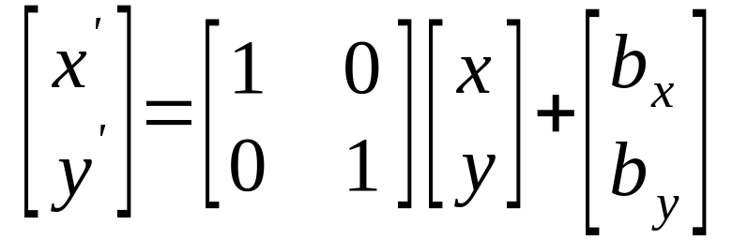
2D Translation
Moves an object
y
y
b_{y}
x
b_{x}
x

Slide 15

Translation - Lenna

Slide 16

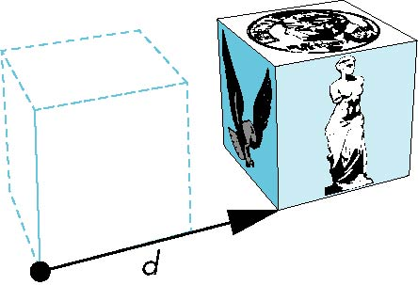
How many ways?
Although we can move a point to a new location in infinite ways, when we move many points there is usually only one way
object
translation: every point displaced
by same vector
COMPUTER VISION

Slide 17
Translation Using Representations
Using the homogeneous coordinate representation in some frame
p=[ x y z 1]^{T}
p’=[x’ y’ z’ 1]^{T}
d=[dx dy dz 0]^{T}
Hence p’ = p + d or
x’=x+d_{x}
y’=y+d_{y}
z’=z+d_{z}
note that this expression is in
four dimensions and expresses
point = vector + point
COMPUTER VISION

Slide 18
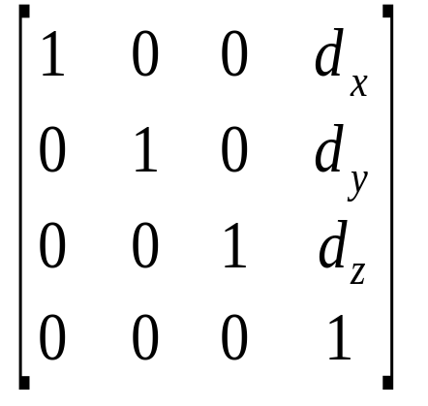
Translation Matrix
We can also express translation using a
4 x 4 matrix T in homogeneous coordinates
p’=Tp where
T = T(d_{x}, d_{y}, d_{z}) =
This form is better for implementation because all affine transformations can be expressed this way and multiple transformations can be concatenated together
COMPUTER VISION

Slide 19
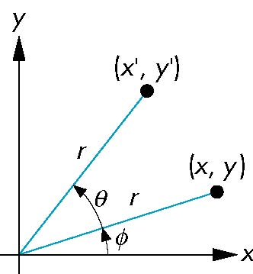
Rotation (2D)
Consider rotation about the origin by θ degrees
  radius stays the same, angle increases by θ
x = r cos (φ + θ)
y = r sin (φ + θ)
x’=x cos θ –y sin θ
y’ = x sin θ + y cos θ
x = r cos φ
y = r sin φ
COMPUTER VISION

Slide 20
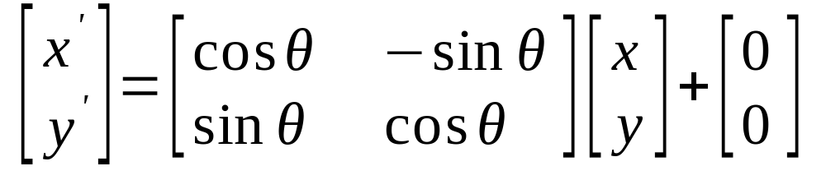
2D Rotation
Rotate counter-clockwise about the origin by an angle θ
y
y
θ
x
x

Slide 21
Rotating About An Arbitrary Point
What happens when you apply a rotation transformation to an object that is not at the origin?
Solution:
  Translate the center of rotation to the origin
  Rotate the object
  Translate back to the original location

Slide 22
Rotating About An Arbitrary Point
y
y
x
x
y
y
x
x

Slide 23
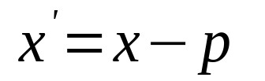
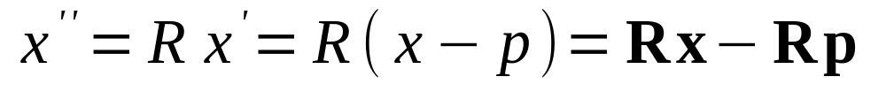
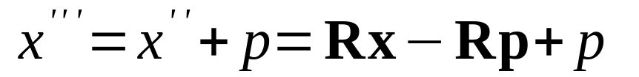
Back to Rotation About a Pt
Say R is the rotation matrix to apply, and p is the point about which to rotate
Translation to Origin:
Rotation:
Translate back:
The translation component of the composite transformation involves the rotation matrix. What a mess!

Slide 24

Rotation -Lenna

Slide 25
Rotation about the z axis
Rotation about z axis in three dimensions leaves all points with the same z
  Equivalent to rotation in two dimensions in planes of constant z
  or in homogeneous coordinates
  p’=R_{z}(θ)p
x’=x cos θ –y sin θ
y’ = x sin θ + y cos θ
z’ =z
COMPUTER VISION

Slide 26
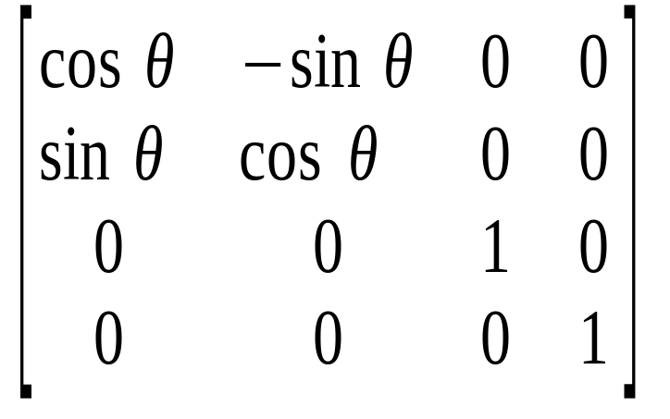
Rotation Matrix
R = R_{z}(θ) =
COMPUTER VISION

Slide 27
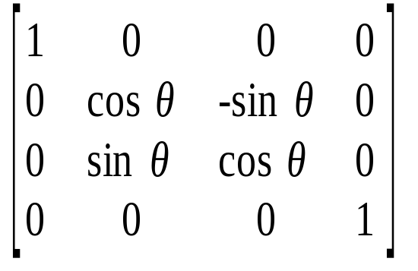
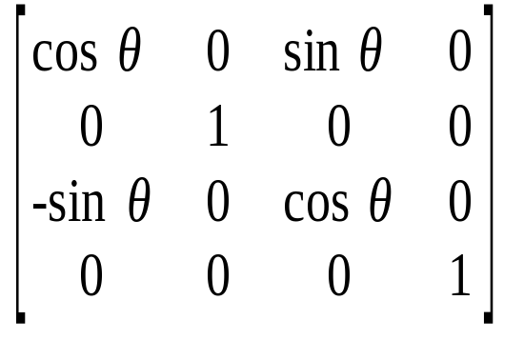
Rotation about x and y axes
Same argument as for rotation about z axis
  For rotation about x axis, x is unchanged
  For rotation about y axis, y is unchanged
R = R_{x}(θ) =
R = R_{y}(θ) =
COMPUTER VISION

Slide 28
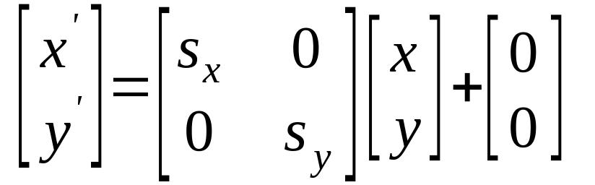
2D Scaling
Resizes an object in each dimension
y
y
s_{y}y
y
x
x
s_{x}x
x

Slide 29
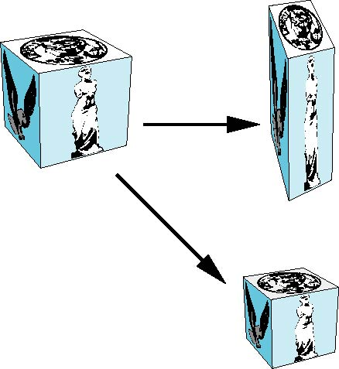
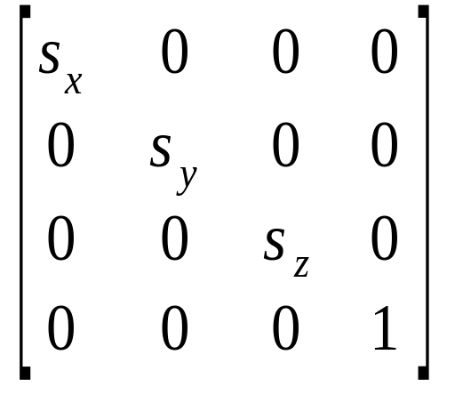
Scaling
Expand or contract along each axis (fixed point of origin)
x’=s_{x}x
y’=s_{y}x
z’=s_{z}x
p’=Sp
S = S(s_{x}, s_{y}, s_{z}) =
COMPUTER VISION

Slide 30
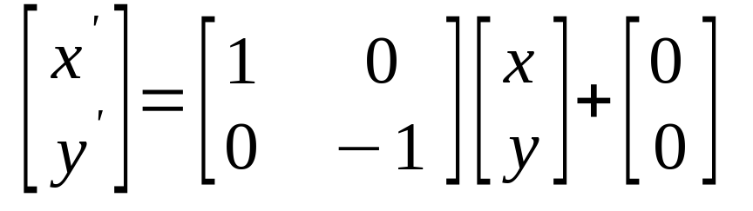
Reflect About X Axis
x
x
What is the matrix for reflect about Y axis?

Slide 31
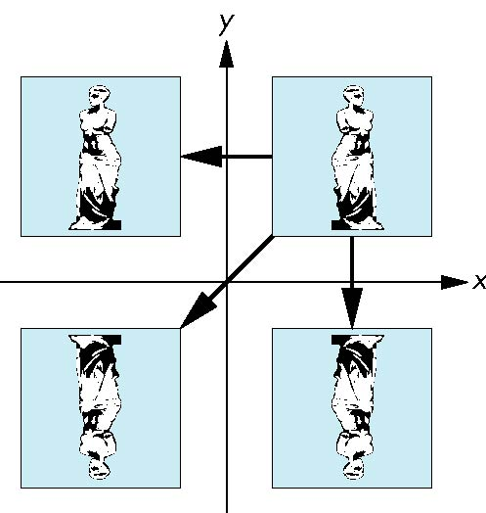
Reflection
corresponds to negative scale factors
s_{x} = -1 s_{y} = 1
original
s_{x} = -1 s_{y} = -1
s_{x} = 1 s_{y} = -1
COMPUTER VISION

Slide 32

Reflection - Lenna

Slide 33
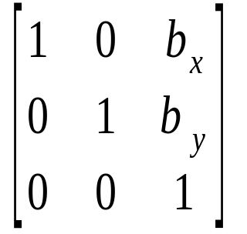
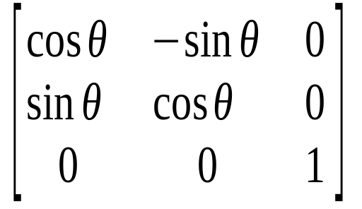
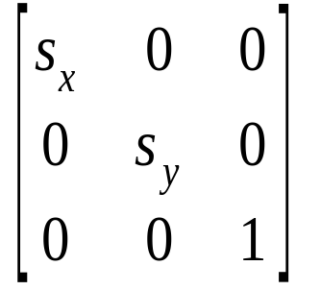
Basic Transformations
Translation: Rotation:
Scaling:

Slide 34
Inverses
Although we could compute inverse matrices by general formulas, we can use simple geometric observations
  Translation: T⁻¹(d_{x}, d_{y}, d_{z}) = T(-d_{x}, -d_{y}, -d_{z})
  Rotation: R ⁻¹(θ) = R(-θ)
    Holds for any rotation matrix
    Note that since cos(-θ) = cos(θ) and sin(-θ)=-sin(θ)
    R ⁻¹(θ) = R ^{T}(θ)
  Scaling: S⁻¹(s_{x}, s_{y}, s_{z}) = S(1/s_{x}, 1/s_{y}, 1/s_{z})
COMPUTER VISION

Slide 35
Concatenation
We can form arbitrary affine transformation matrices by multiplying together rotation, translation, and scaling matrices
Because the same transformation is applied to many vertices, the cost of forming a matrix M=ABCD is not significant compared to the cost of computing Mp for many vertices p
The difficult part is how to form a desired transformation from the specifications in the application
COMPUTER VISION

Slide 36
Order of Transformations
Note that matrix on the right is the first applied
Mathematically, the following are equivalent
p’ = ABCp = A(B(Cp))
Note many references use column matrices to represent points. In terms of column matrices
p^{’T} = p^{T}C^{T}B^{T}A^{T}
COMPUTER VISION

Slide 37
General Rotation About the Origin
A rotation by θ about an arbitrary axis
can be decomposed into the concatenation
of rotations about the x, y, and z axes
R(θ) = R_{z}(θ_{z}) R_{y}(θ_{y}) R_{x}(θ_{x})
y
v
θ_{x} θ_{y} θ_{z} are called the Euler angles
θ
Note that rotations do not commute
We can use rotations in another order but
with different angles
x
z
COMPUTER VISION

Slide 38
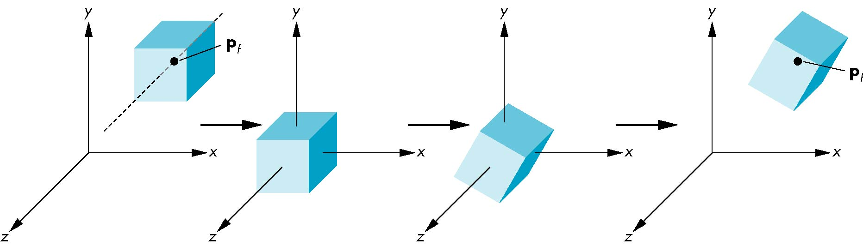
Rotation About a Fixed Point other than the Origin
Move fixed point to origin
Rotate
Move fixed point back
M = T(p_{f}) R(θ) T(-p_{f})
COMPUTER VISION

Slide 39
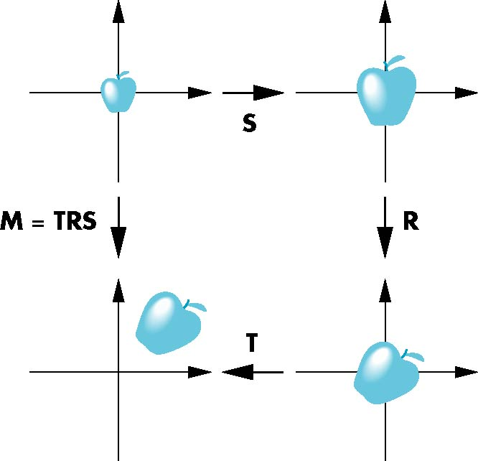
Instancing
In modeling, we often start with a simple object centered at the origin, oriented with the axis, and at a standard size
We apply an instance transformation to its vertices to
Scale
Orient
Locate
COMPUTER VISION

Slide 40
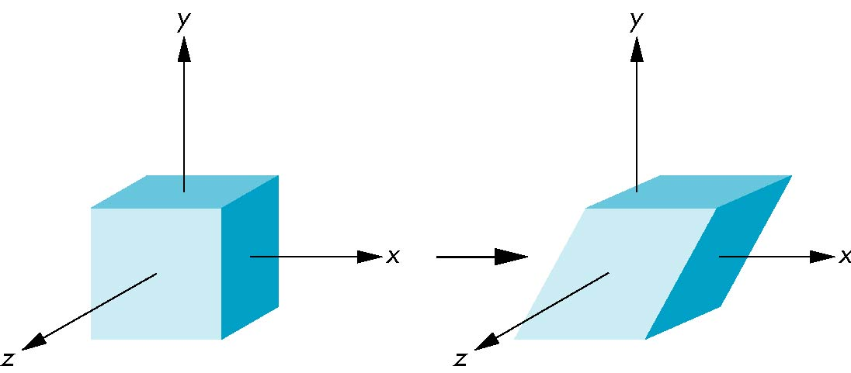
Shear
Helpful to add one more basic transformation
Equivalent to pulling faces in opposite directions
COMPUTER VISION

Slide 41
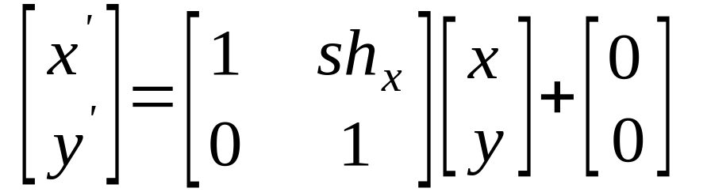
X-Axis Shear
Shear along x axis (What is the matrix for y axis shear?)
y
y
x
x

Slide 42
Shearing along x axis
y
y
(2,1)
(3,1)
(0,1)
(1,1)
(0,0)
(1,0)
(1,0)
x
(0,0)
x
sh_{x}=2

Slide 43
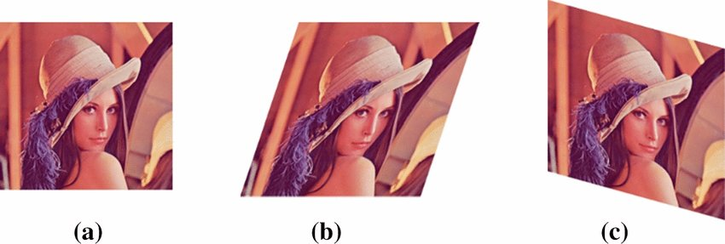
Shearing - Lenna

Slide 44
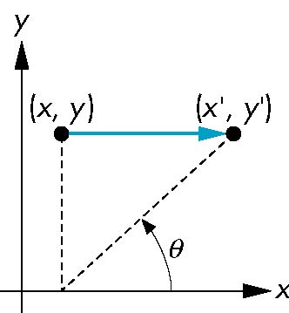
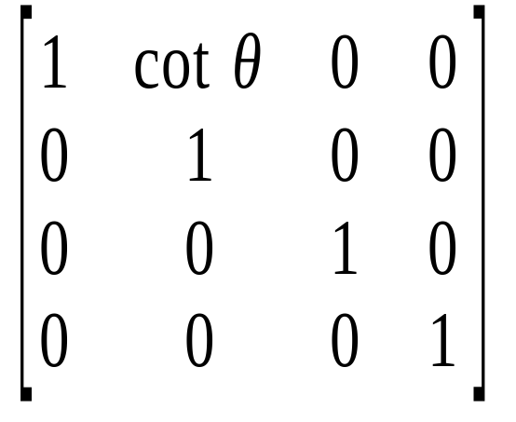
Shear Matrix
Consider simple shear along x axis
x’ = x + y cot θ
y’ = y
z’ = z
H(θ) =
COMPUTER VISION

